Slide 1

Formula One Prediction
Akul Arun
(S10243523)
Notes:
Welcome to my DW ASG 1 presentation where I will be sharing more about my model for the supermarket sales forecast

Slide 2
Table of Contents
01
04
Problem Understanding
Data Transformation
02
05
Data Cleansing
Feature Engineering
03
06
Wrangling on Multiple Tables + Data Exploration
Model Performance
Notes:
These are the contents I will be sharing today.

Slide 3
Problem Understanding
Aim
Predict if the driver is top 3 in a race
Problem Type
Classification
Results_mod.csv → results_df
races_mod.csv → races_df
drivers_mod.csv → drivers_df
constructors_mod.csv → constructors_df
circuits_mod.csv → circuits_df
Datasets
Notes:
My aim for this data-wrangling process is to create a model using Python that will be able to predict the sales of each product at a particular outlet. My model will help your management team to understand the effect of the properties of products and outlets which play a key role in increasing sales.

Slide 4
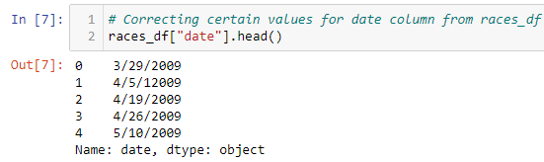
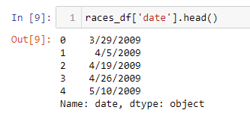
Correction of date (races_df)
Notes:
There are many outliers in the ‘Item_Visibility’. Furthermore, I was not going to drop this variable as this variable will be very important for the management and logistics teams in deciding the number of products to stock in an outlet.
I decided to transform the variables before dealing with outliers as transformation can reduce the number of outliers.

Slide 5
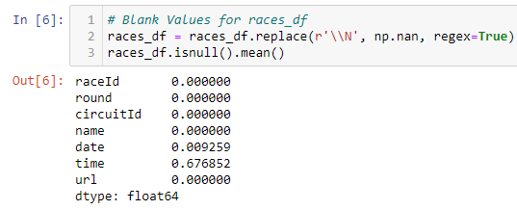
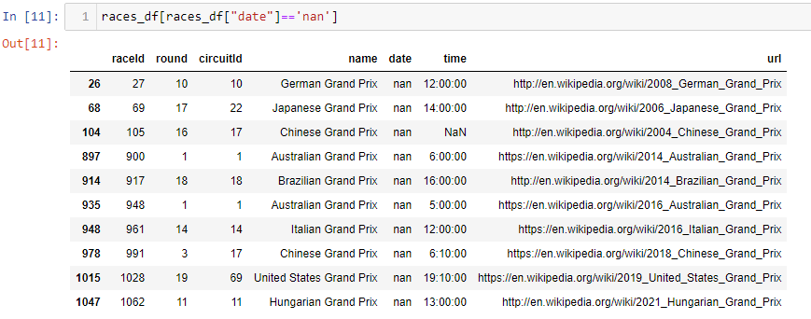
Filling in Missing Values for date (races_df)
Notes:
There are many outliers in the ‘Item_Visibility’. Furthermore, I was not going to drop this variable as this variable will be very important for the management and logistics teams in deciding the number of products to stock in an outlet.
I decided to transform the variables before dealing with outliers as transformation can reduce the number of outliers.

Slide 6
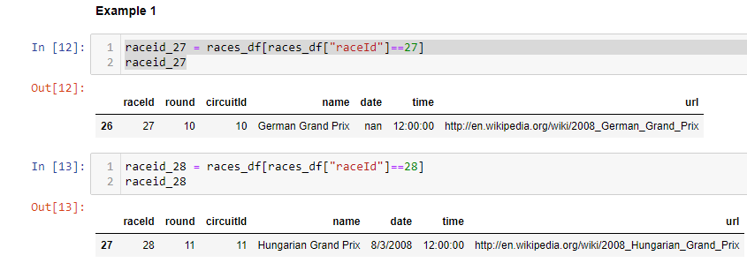

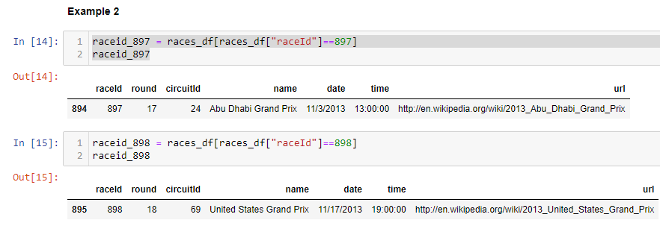
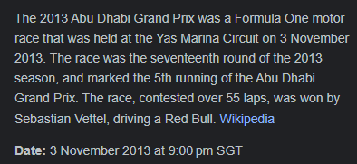
Pattern for Date Missing Values (races_df)
Next Race happened after 14 days of German Grand Prix
Next Race happened after 14 days of Abu Dhabi Grand Prix
Notes:
There are many outliers in the ‘Item_Visibility’. Furthermore, I was not going to drop this variable as this variable will be very important for the management and logistics teams in deciding the number of products to stock in an outlet.
I decided to transform the variables before dealing with outliers as transformation can reduce the number of outliers.

Slide 7
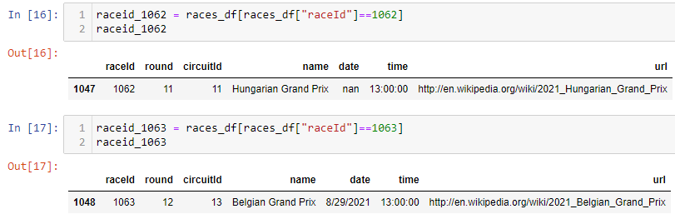
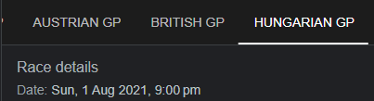
Outlier of Pattern (races_df)
Next Race happened after 28 days of German Grand Prix
Notes:
There are many outliers in the ‘Item_Visibility’. Furthermore, I was not going to drop this variable as this variable will be very important for the management and logistics teams in deciding the number of products to stock in an outlet.
I decided to transform the variables before dealing with outliers as transformation can reduce the number of outliers.

Slide 8
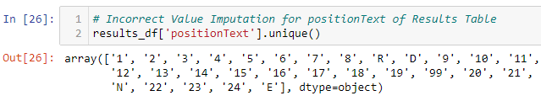
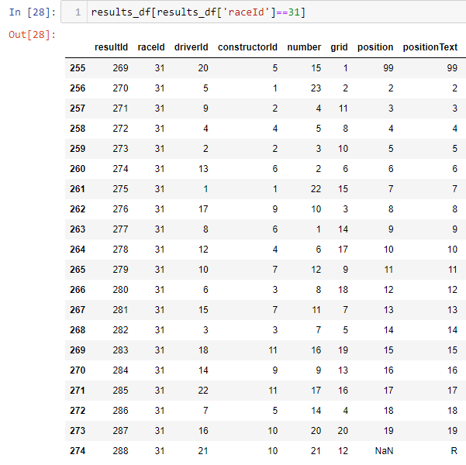
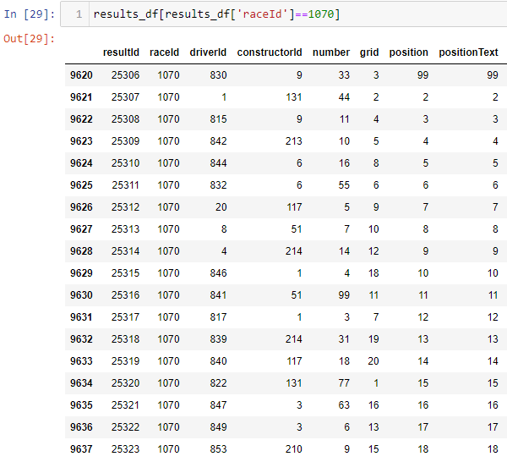
Correction of positionText (results_df)
99 should be 1
Notes:
When I saw that there was a category for 99 in positionText, I got suspicious as there has never been 99 racers in Formula 1. I identified another pattern while correcting positionText. As seen from the 2 examples, There are 99 values at the places where 1 should be.

Slide 9
Wrangling on Multiple Tables
Changing Data Types of Features
Feature Extraction & Creation
Subsetting, Grouping & Merging Tables
Notes:
Now I will be moving on to the data cleansing section. Missing data has to be removed or replaced as models do not accept null values. An outlier is an extreme data point that is significantly different from other data points in the variable.
Outliers can skew the data distribution which can cause the model to perform poorly.

Slide 10

Extraction and Creation of features
Extraction of Features
Creation of Features
Year from date (races_df)
Month from date (races_df)
Day from date (races_df)
Seasons from month (races_df)
Driver age_at_race using dob from drivers_df and date from races_df (Mathematical Calculation)
Driver names by concatenating forename and surname from drivers_df
Driver_error_dnf using statusId from results_df and refering to the status table (DNF due to driver error)
Constructor_error_dnf using statusId from results_df and refering to the status table (DNF due to car problem)
Notes:
There are many outliers in the ‘Item_Visibility’. Furthermore, I was not going to drop this variable as this variable will be very important for the management and logistics teams in deciding the number of products to stock in an outlet.
I decided to transform the variables before dealing with outliers as transformation can reduce the number of outliers.

Slide 11
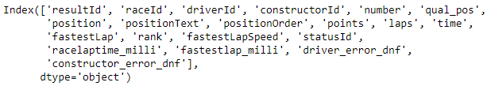
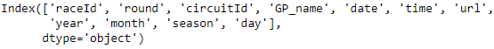
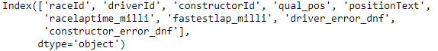
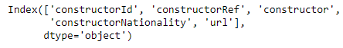
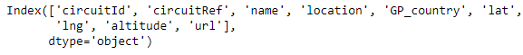
Subsetting
results_df
01
races_df
02
drivers_df
03
constructors_df
04
Circuits_df
05

Slide 12

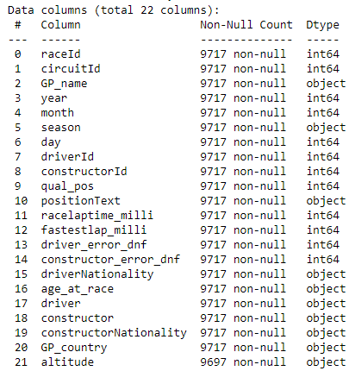
Merging of Tables
Merged_df
Df1 = Results_df + Races_df
01
Inner Join on RaceId
Df2 = df1 + drivers_df
02
Inner Join on driverId
Df3 = df2 + constructors_df
03
Inner Join on constructorId
Df4 = df3 + circuit_df
04
Inner Join on circuitId
05
Merged_df = df4

Slide 13

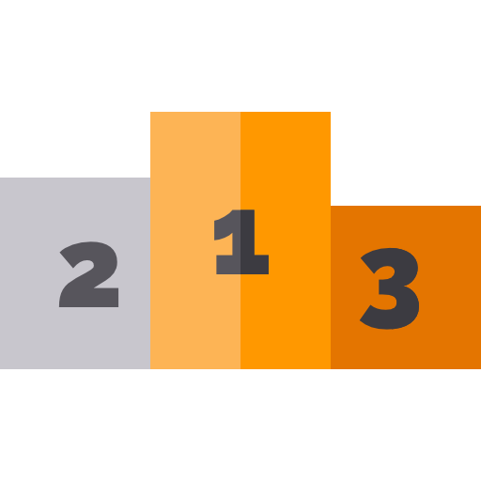
Creation of Target feature & Additional Features
Target Feature
Creation of Features
Has Binary Values (1 for podium finish, 0 for no podium finish)
Driver_finish_percent (Grouping)
Constructor_finish_percent (Grouping)
Driver_podium_percent (Grouping)
constructor_podium_percent (Grouping)
Driver_home - Check if race is happening where driver is born
Constructor_home - Check if race is happening where company was started
Notes:
There are many outliers in the ‘Item_Visibility’. Furthermore, I was not going to drop this variable as this variable will be very important for the management and logistics teams in deciding the number of products to stock in an outlet.
I decided to transform the variables before dealing with outliers as transformation can reduce the number of outliers.

Slide 14
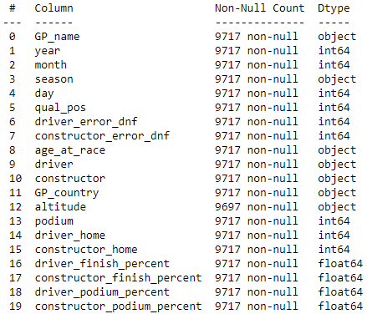
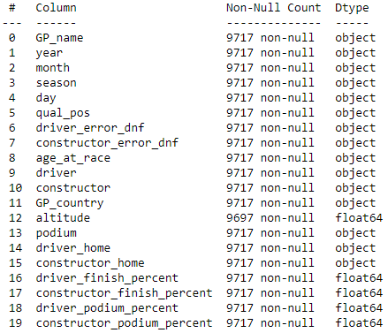
Data Type Correction
Before
After
Vs
Used for Train-Test Split
Notes:
The raw dataset contains 12 variables. 7 of these variables are categorical variables and the rest of the 5 variables are numerical variables. However, I had converted ‘Outlet_Establishment_Year’ from int64 type to object data type and will be explaining more in the data cleansing part. I converted before making the comparison to make more accurate comparisons.

Slide 15
Data Transformation
Missing Value Imputation using Pipelines
Categorical Data Transformation
01
02
Label Encoding
Mean Imputation
Numerical Data Transformation
03
04
Dealing with Outliers
Equal-Width Discretization
Capping
Binning
05
Equal-Frequency Discretization
Notes:
I conducted around 25 different tests, and these are the configurations I used to obtain the most accurate model. In the next few sections of this presentation, I will only be focusing on these techniques.

Slide 16
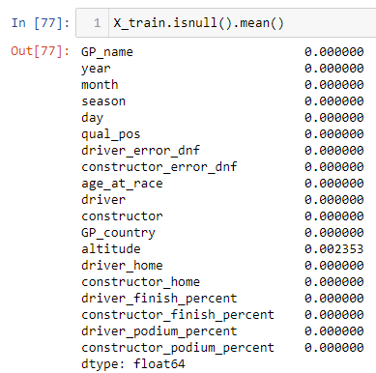
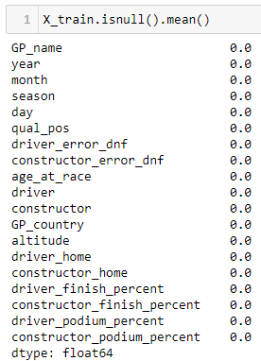
Missing Value Imputation
Before
After
Mean Imputation
Notes:
I found that only Outlet_Size had missing data with about 28% of the data missing. Then, I used a feature-engine pipeline to impute the missing data with the most frequently appearing value.

Slide 17
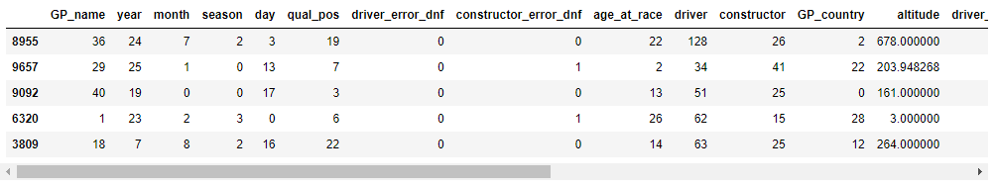
Categorical Variable Transformation
Theory
Label Encoding
Replaces values with the average target value of their category
Maintains Dimensionality
Output data
Notes:
Mean encoding replaces values with the average target value of their category. So in this case, it will replace the value with the average sales values of that category.

Slide 18
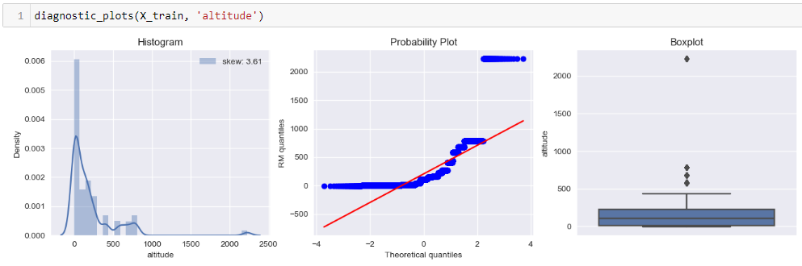
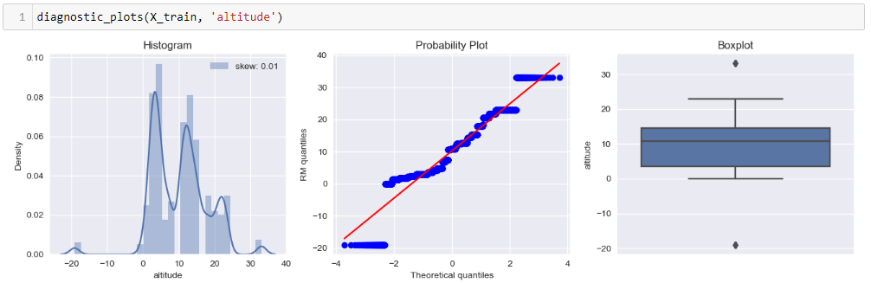
Transforming altitude
01
02
Yeo-Johnson Transformation
Altitude (Before)
Altitude (After)
Notes:
Yeo-Johnson transformation is the most versatile technique as it can be used on any type of value. As seen from the histogram, the distribution has become more normal and there are no more outliers.

Slide 19
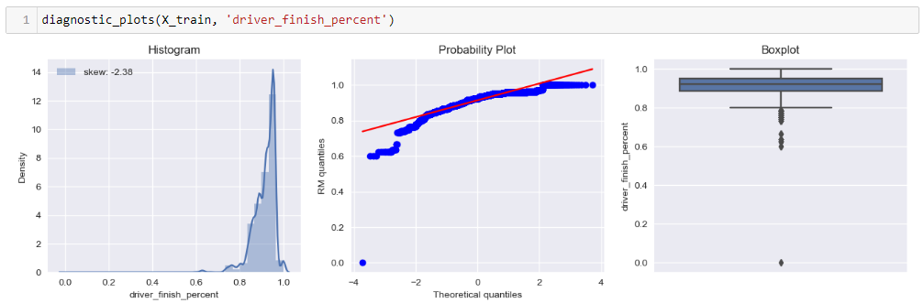
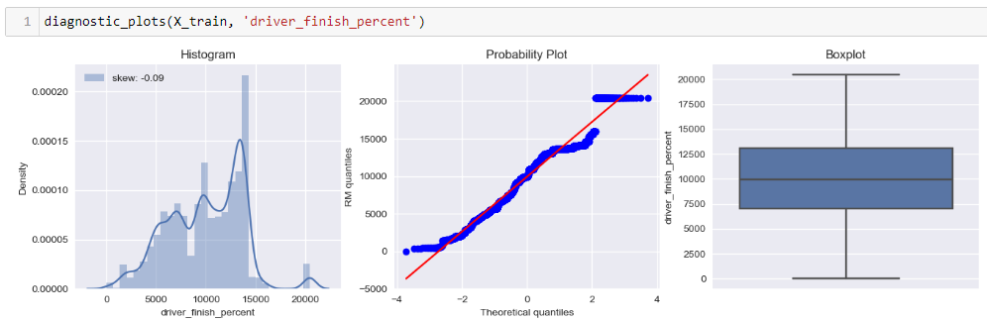
Transforming driver_finish_percent
01
02
Yeo-Johnson Transformation
driver_finish_percent (Before)
driver_finish_percent (After)
Notes:
Power transformation allows you to define the power that is applied to the original values. However, there no obvious changes to the graphs except for the changes in the scales after transformation.

Slide 20
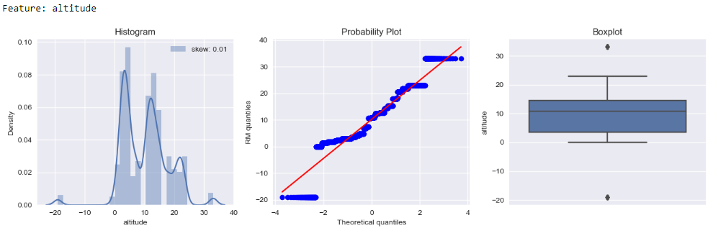
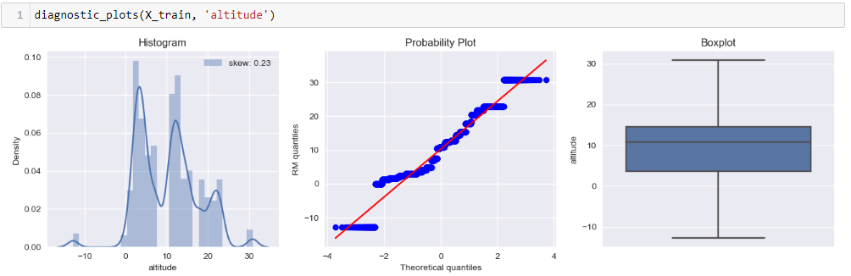
Dealing with Outliers
Before
After
Capping
Notes:
I obtained the best results when I used winsorization and I think this is because this method replaces values instead of removing them, which trimming does. More data points allow the model to understand the dataset better and produce more accurate results. Winsorization also replaces values with quantiles which can give more accurate results than replacing values with arbitrary maximum and minimum values like capping does.

Slide 21
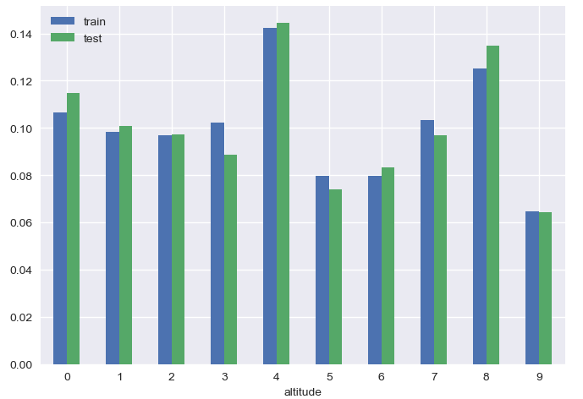
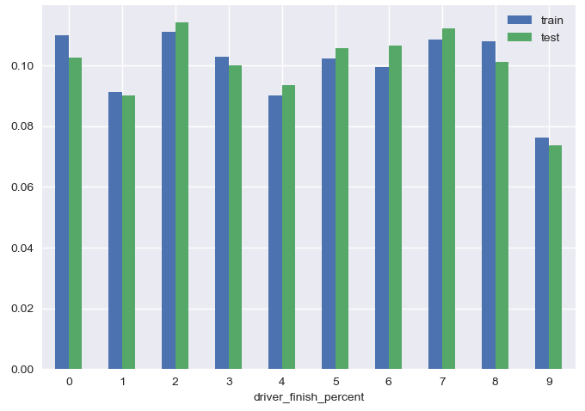
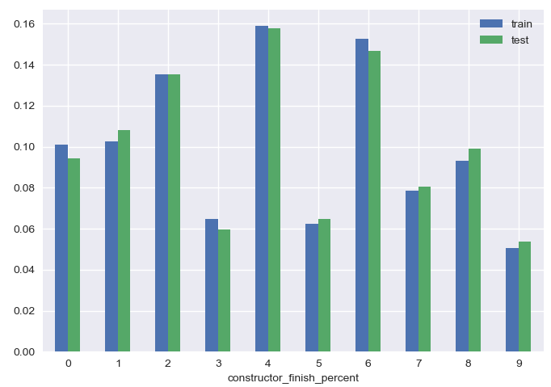
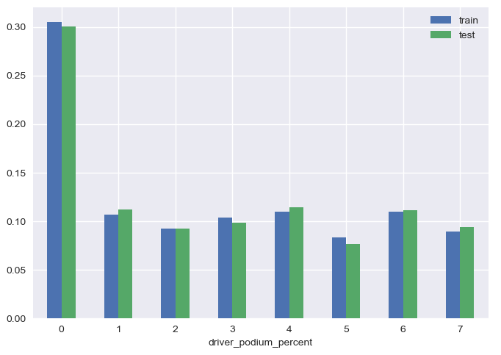
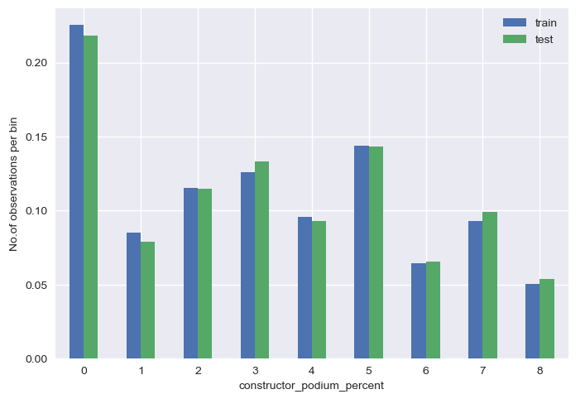
Binning
Equal-Frequency Discretization
altitude
Driver_finish_percent
constructor_finish_percent
Driver_podium_percent
Constructor_podium_percent
Notes:
For equal-width discretization, Values are sorted into intervals of the same bin width. Equal-frequency Discretization divides the values into intervals that carry the same proportion of observations by dividing the continuous variable into quantiles. When evaluating the model, I found that changing the binning method did not affect the accuracy of the model.

Slide 22
Feature Engineering
Feature Engineering Done in this Project
Scaling
Adding new features
Compare feature importance
Algorithms converge faster
Improved model performance
ML models sensitive to scale
Bigger scale features dominate over smaller scale features
Provide the model with more information
Introduce more relationships
Decrease the noise of data
Increase accuracy
Polynomial Expansion
Notes:
Feature engineering can improve the accuracy of models. As part of feature engineering, I did scaling and added new features using polynomial expansion.

Slide 23
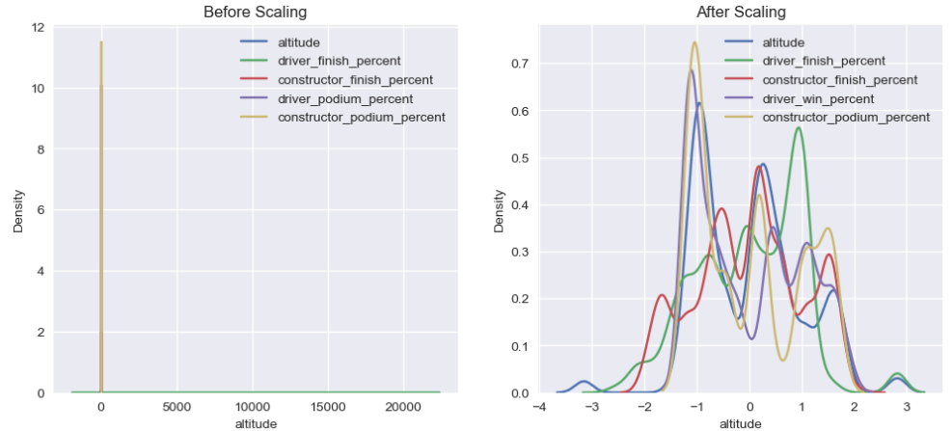
Scaling
Before Scaling
Standardisation
After Scaling
Notes:
Standardization is the process of centering the variable at zero and standardizing the variance to 1. After scaling, the scale has reduced in size significantly and we can see the variables are sharing the same scale. With the KDE plots, the management team will be able to see the differences in the importance of how item_visibility and item_MRP to see if the number of products in a store or the retail price of the product affects sales.

Slide 24
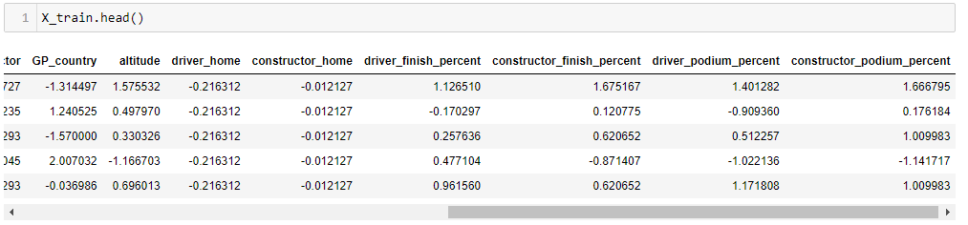
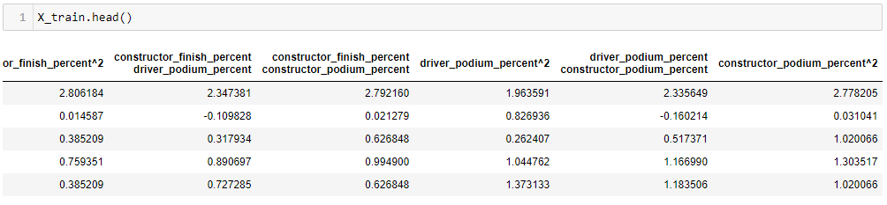
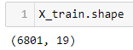
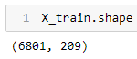
Polynomial Expansion
Degree = 2
Before Expansion
After Expansion
Notes:
If the degree is greater than 2, the train model score increases but the test model score decreases. This is not desirable as we want the highest possible test model score. This might be due to overfitting as there is too many features and the model becomes too complex that it starts to perform poorly. This is because the model will start predicting results based on dummy variables created.

Slide 25

Model Performance
Naïve Baseline
Logistic Regression
Notes:
There are many outliers in the ‘Item_Visibility’. Furthermore, I was not going to drop this variable as this variable will be very important for the management and logistics teams in deciding the number of products to stock in an outlet.
I decided to transform the variables before dealing with outliers as transformation can reduce the number of outliers.

Slide 26


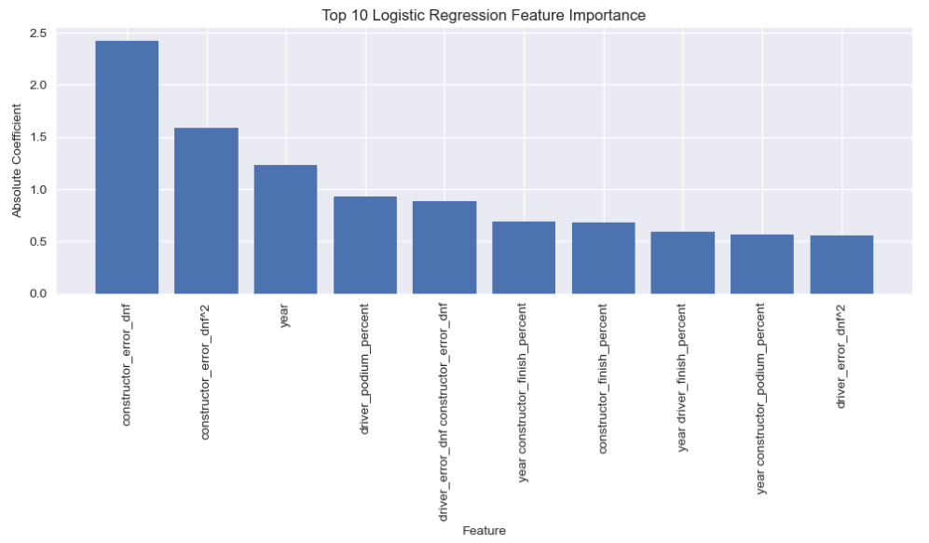
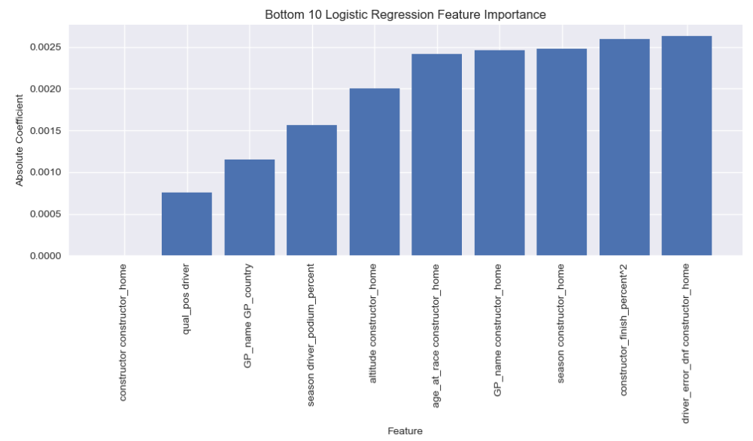


Feature Importance

Slide 27
Thank You

Slide 28
Best Model
Missing Value Imputation using Pipelines
Categorical Data Transformation
01
02
Mean Encoding
Item_Visibility: Yeo-Johnson Transformation
Item_MRP:
Power Transformation
Numerical Data Transformation
Dealing with Outliers
03
04
Equal-Width Discretization
Standardisation
Scaling
Outlier dealing Method on Target Variable
05
06
Polynomial Expansion, degree= 2
Winsorization
Notes:
I conducted around 25 different tests, and these are the configurations I used to obtain the most accurate model. In the next few sections of this presentation, I will only be focusing on these techniques.

Slide 29
Summary
01
02
03
04
1950s
1960s
1970s
1980s
Simple algorithms
Bayesian methods
AI winter caused by pessimism
Resurgence in ML research
Mercury is the closest planet to the Sun
Jupiter is a gas giant and the biggest planet
Venus has a beautiful name, but it’s very hot
Mercury is the closest planet to the Sun
05
06
07
1990s
2000s
2010s
Data-driven approach
Support-Vector Clustering
Deep learning popularity
The Earth is the third planet from the Sun
Ceres is located in the main asteroid belt
Venus has a beautiful name, but it’s very hot

Slide 30
Formula One Prediction
Akul Arun
(S10243523)
Notes:
Welcome to my DW ASG 1 presentation where I will be sharing more about my model for the supermarket sales forecast

Slide 31
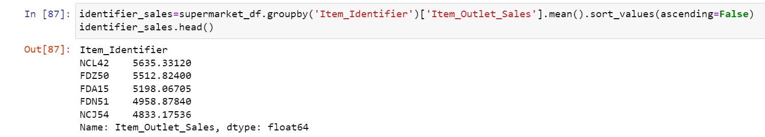
Item_Identifier vs Item_Outlet_Sales
Notes:
For the relationship between ‘Item_Identifier’ and the target variable, different products bring in different amounts of sales. I decided to show the top 5 items with the most sales as there are over 1500 different items.

Slide 32
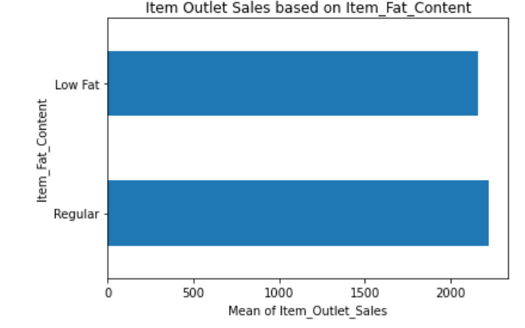
Item_Fat_Content vs Item_Outlet_Sales
Notes:
Next, I discovered that regular-fat items brought in more sales than low-fat items by a tiny margin.

Slide 33
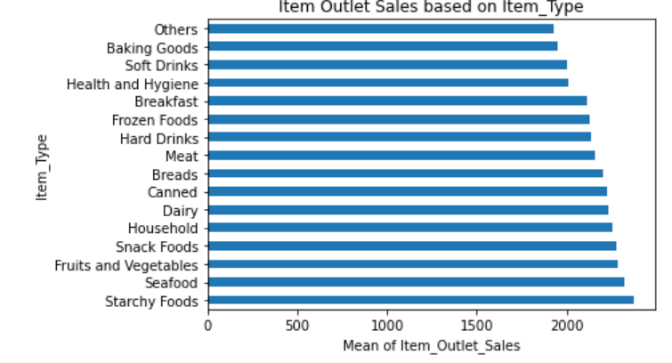
Item_Type vs Item_Outlet_Sales

Slide 34
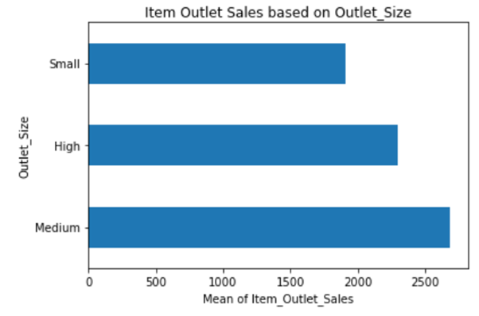
Outlet_Size vs Item_Outlet_Sales
Notes:
I wanted to determine if the size of the store had any effect on the mean sales. I thought that bigger outlets would generate more sales as they can house more products. However, after comparing, I found that I was wrong as the medium-sized outlets generated the most sales.

Slide 35
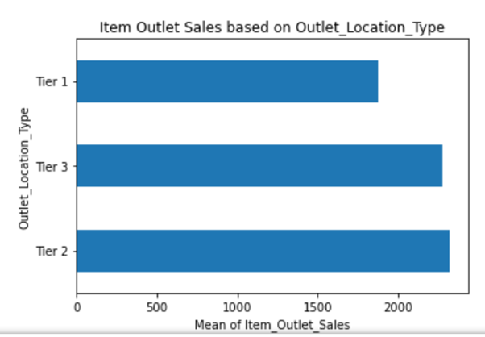
Outlet_Location_Type vs Item_Outlet_Sales
Notes:
This bar chart comparing outlet location type and the target variable will help you decide which type of location to open more stores in. From the bar chart, its better to open stores in tier 2 and 3 locations.

Slide 36
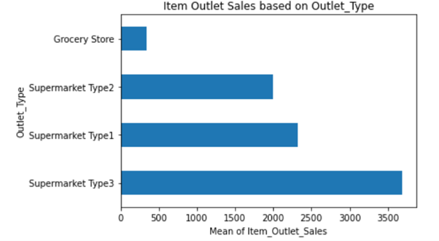
Outlet_Type vs Item_Outlet_Sales
Notes:
This bar chart helps your team decide which type of stores to build more in the future. From the bar chart, its better to open supermarkets rather than grocery stores.

Slide 37
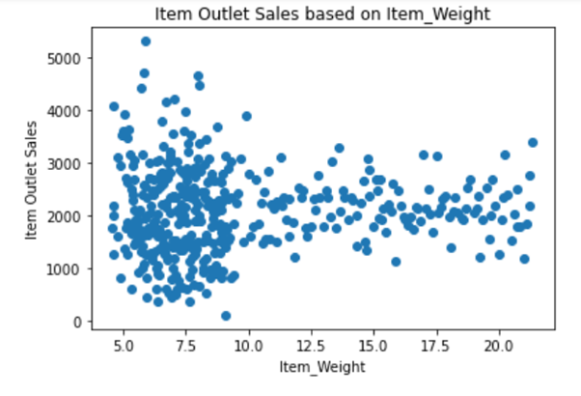
Item_Weight vs Item_Outlet_Sales
No Relationship
Notes:
Now, I will be comparing numerical variables to the target variable. I was not expecting a strong relationship between weight and sales as generally in real life, weight does not affect sale of items. The scatterplot supports my theory as it does not show any definitive relationship.

Slide 38
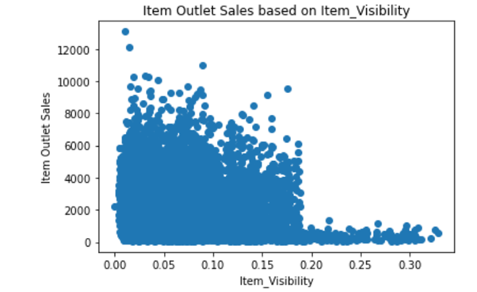
Item_Visibility vs Item_Outlet_Sales
Item_Visibility Item_Outlet_Sales
Notes:
I was expecting a strong relationship between ‘Item_Visibility’ and the sales as I thought that products with more display area will rake in more sales. Basically my hypothesis was that as item visibility increases, the sales will also increase. However, it was the opposite as there is a decreasing trend in sales as item visibility increases which was interesting.

Slide 39

Item_MRP vs Item_Outlet_Sales
Item_MRP Item_Outlet_Sales
Notes:
We can see an increasing trend when comparing item MRP and sales which is expected as when the price of the item increases, the sales dollar amount of product should be higher if enough products are sold.

Slide 40

Heatmap of Numerical Variables
Item_Weight vs Target Variable
Correlation: 0.014
Notes:
The heatmap shows the correlation of all numerical variables but we only focus on the last row. The lower the score, the less correlation between the variables and vice versa. Item_Weight has the lowest correlation while Item_MRP has the highest correlation with the target variable. I decided to drop Item_Weight as it did not have a strong relationship with the target variable.

Slide 41


Standardization of values in Item_Fat_Content
Before replacing
After replacing
Notes:
In the raw dataset, there were 5 categories in Item_Fat_Content at first and some of them were shortforms. Hence, I replaced the short form values and changed the casing to the proper form.

Slide 42


Changing Data Type of Outlet_Establishment_Year
Before
After
Notes:
At first the data type of 'Outlet_Establishment_Year' was int64 data type but I thought year data was more categorical in nature in this context. Hence, I converted it to a categorical variable.

Slide 43



Outliers in Target Variable
Different values of Numerical Variables
Top 5 Outliers
Visualisations showing outliers and distribution
Notes:
‘Item_Outlet_Sales’ has extreme values as the difference between the maximum and minimum compared to the mean value of ‘Item_Outlet_Sales’ is very large. The Box plot shows there are many outliers present.

Slide 44



Data Transformation
Categorical Variable Transformation
Mean Encoding
Numerical Variable Transformation
Item_Visibility: Yeo-Johnson Transformation
Item_MRP: Power Transformation
Binning
Equal Width Discretization
Notes:
Now, I will be talking about data transformation. Categorical encoding has to be done as some models only accept numbers. Numerical variable transformation is done to make distributions more normal and reduce outliers in some cases. Binning is done to reduce noise and non-linearity in the dataset.

Slide 45

Dropping Item_Identifier
Item_Identifier
Picture shows cardinality of categorical variables
Item_Identifier cardinality: 1559
Too high cardinality can lead to lower performance
Notes:
I dropped the ‘Item_Identifier’ variables before doing the categorical encoding. As seen from the picture, ‘Item_Identifier’ had a much cardinality than the other categorical variables. High cardinality can lead to poor model performance, and memory issues when trying to fit the model due to extremely large matrices of values from countless dummy variables.

Slide 46


Numerical Variable Scatterplot Before Polynomial Expansion
Item_Visibility
Item_MRP
Notes:
Since the numerical variables do not have a linear relationship, I used polynomial expansion to make the relationship more linear.

